Slide 1
CSE 3100: Systems Programming
Lecture 5: Arrays and Pointer Basics
Department of Computer Science and Engineering
University of Connecticut

Slide 2
1. Arrays in C
2. Passing By Value
3. Passing By Reference
4. Pointers and Memory in C

Slide 3
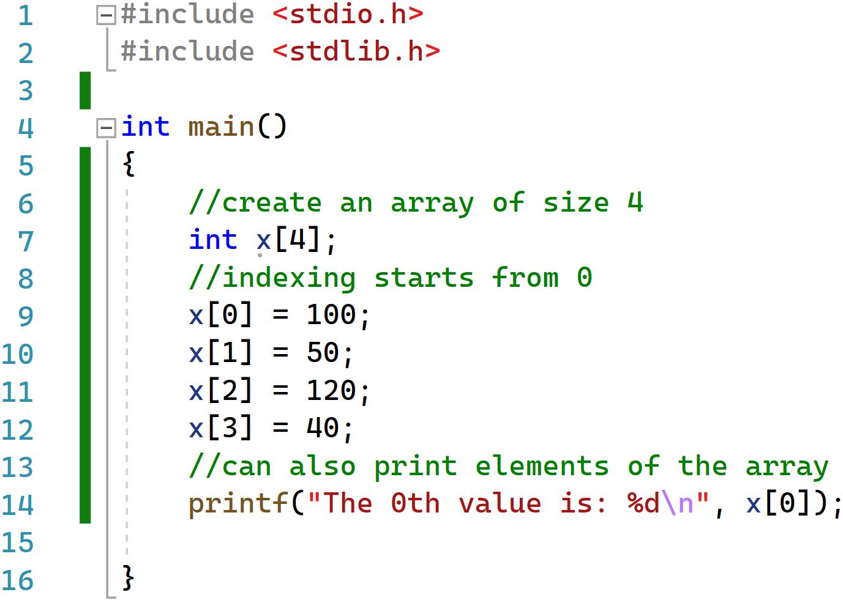
What happens if you want to associate multiple values with a variable?
Use an array!

Slide 4
What happens if you want to associate multiple values with a variable?
Use an array!

Slide 5

What happens if you want to associate multiple values with a variable?
Use an array!

Slide 6
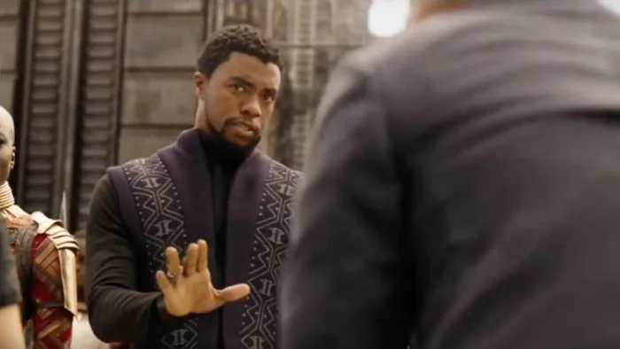
Arrays in C
Arrays represent a linear, contiguous collection of “things”
Each “thing” in the array has the same fixed type.
Examples
Array of characters
Array of integers
Array of doubles
Arrays of arrays….
C Programming
Arrays with different types of variables
“We don’t do that here.”

Slide 7
Syntax for Array Initialization
// initialize array with a list
int y[5] = {1, 2, 3, 4, 5};
// Number of elements is optional if all elements are listed
int z[] = {1, 2, 3, 4, 5};
// Specify the value of first 2 elements. The rest are set to 0
int a[5] = {1, 2};
// C99. b will have 1, 2, 0, 0, 5.
int b[5] = {1, 2, [4] = 5};

Slide 8
Arrays as Automatic Variables
You can declare arrays inside any function or block
Destroyed when exiting from the function or block
Variable length arrays(VLA, C99) The size of your array can depend on function arguments or other known values
int foo(int n,int k) {
int x[n]; // The value of n is known at this time
// Like other auto variables, x is kept on
// the stack and is NOT initialized
for (int i = 0; i < n; i++)
x[i] = 0;
……
return -1;
}

Slide 9
Array Assignment
You cannot assign a whole array at once to another array
Even when the types match
a.c: In function 'main':
a.c:5:7: error: assignment to expression with array type
x = y;
^
a.c:6:7: error: assignment to expression with array type
x = z;
^
int main() {
int x[10];
int y[20];
int z[10];
x = y;
x = z;
}

Slide 10
Strings are Arrays Too!
A string is a char array that ends with a 0 (null character)
Memory that stores 0 is part of the string
It can be initialized with a list of characters
or a string (double-quoted literal)
#include <stdio.h>
int main()
{
char s[6] = {'H','e','l','l','o','\0'};
char t[6] = "Hello";
char u[] = "Hello";
printf("Array is: %s\n", s);
}

Slide 11
What would this look like in memory?
 | Addr. | Value
s[5] | 505 | 0
s[4] | 504 | 'o'
s[3] | 503 | 'l'
s[2] | 502 | 'l'
s[1] | 501 | 'e'
s[0] | 500 | 'H'
#include <stdio.h>
int main()
{
char s[6] = {'H','e','l','l','o','\0'};
char t[6] = "Hello";
char u[] = "Hello";
printf("Array is: %s\n", s);
}

Slide 12
Arrays and Functions
Arrays can be passed to functions!
With one big caveat…
Calling convention in C
BY VALUE for everything….
EXCEPT arrays…
Arrays are always passed BY REFERENCE
Passed as “pointers” – we‘ll look at pointers soon
Functions cannot return arrays
No easy assignments

Slide 13
1. Arrays in C
2. Passing By Value
3. Passing By Reference
4. Pointers and Memory in C

Slide 14
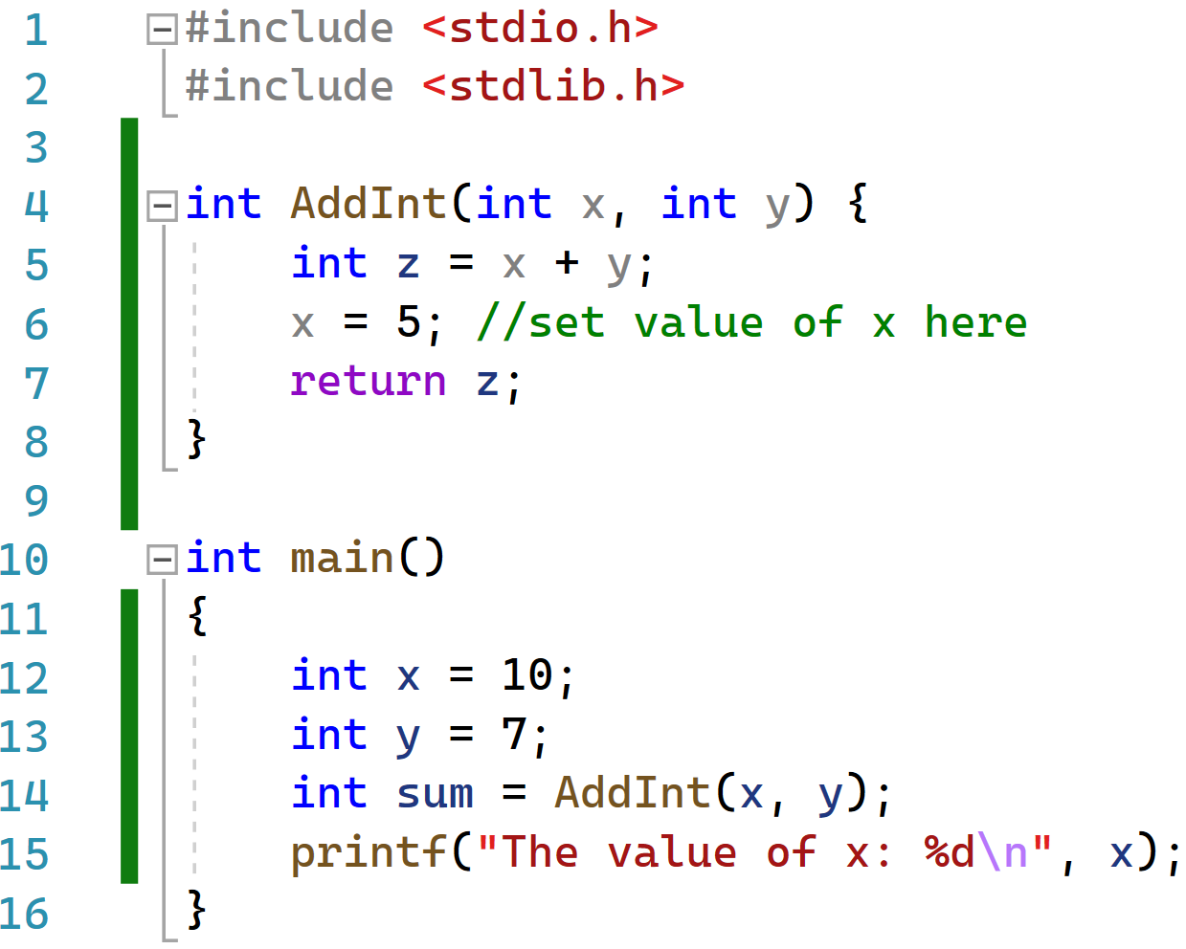

What does passing by value mean?
In this code what will be the value of x at the end?

Slide 15
What is going on here?
Start in main…

Slide 16
What is going on here?
Start in main…
Variables in Main
x =10
y= 7

Slide 17
What is going on here?
Now go to AddInt…
Variables in Main
x =10
y= 7
Variables in AddInt

Slide 18
What is going on here?
Variables in Main
x =10
y= 7
Variables in AddInt
x =10
y= 7

Slide 19
What is going on here?
Variables in Main
x =10
y= 7
Variables in AddInt
x =10
y= 7
z= 17

Slide 20
What is going on here?
Variables in Main
x =10
y= 7
Variables in AddInt
x =5
y= 7
z= 17

Slide 21
What is going on here?
Variables in Main
x =10
y= 7
Variables in AddInt
x =5
y= 7
z= 17

Slide 22
What is going on here?
Variables in Main
x =10
y= 7
sum = 17
Variables in AddInt
x =5
y= 7
z= 17

Slide 23
What is going on here?
Variables in Main
x =10
y= 7
sum = 17
Variables in AddInt
x =5
y= 7
z= 17

Slide 24
Understanding Passing by Value
Pay careful attention to the previous example.
In C for PRIMITIVE datatypes, when you pass them to other functions, they are passed as independent copies.
What is a PRIMITIVE datatype? Int, float, double, long, char…
Passing by value means that the value is passed to the function, but not the variable itself.
What happens for arrays?

Slide 25
1. Arrays in C
2. Passing By Value
3. Passing By Reference
4. Pointers and Memory in C

Slide 26
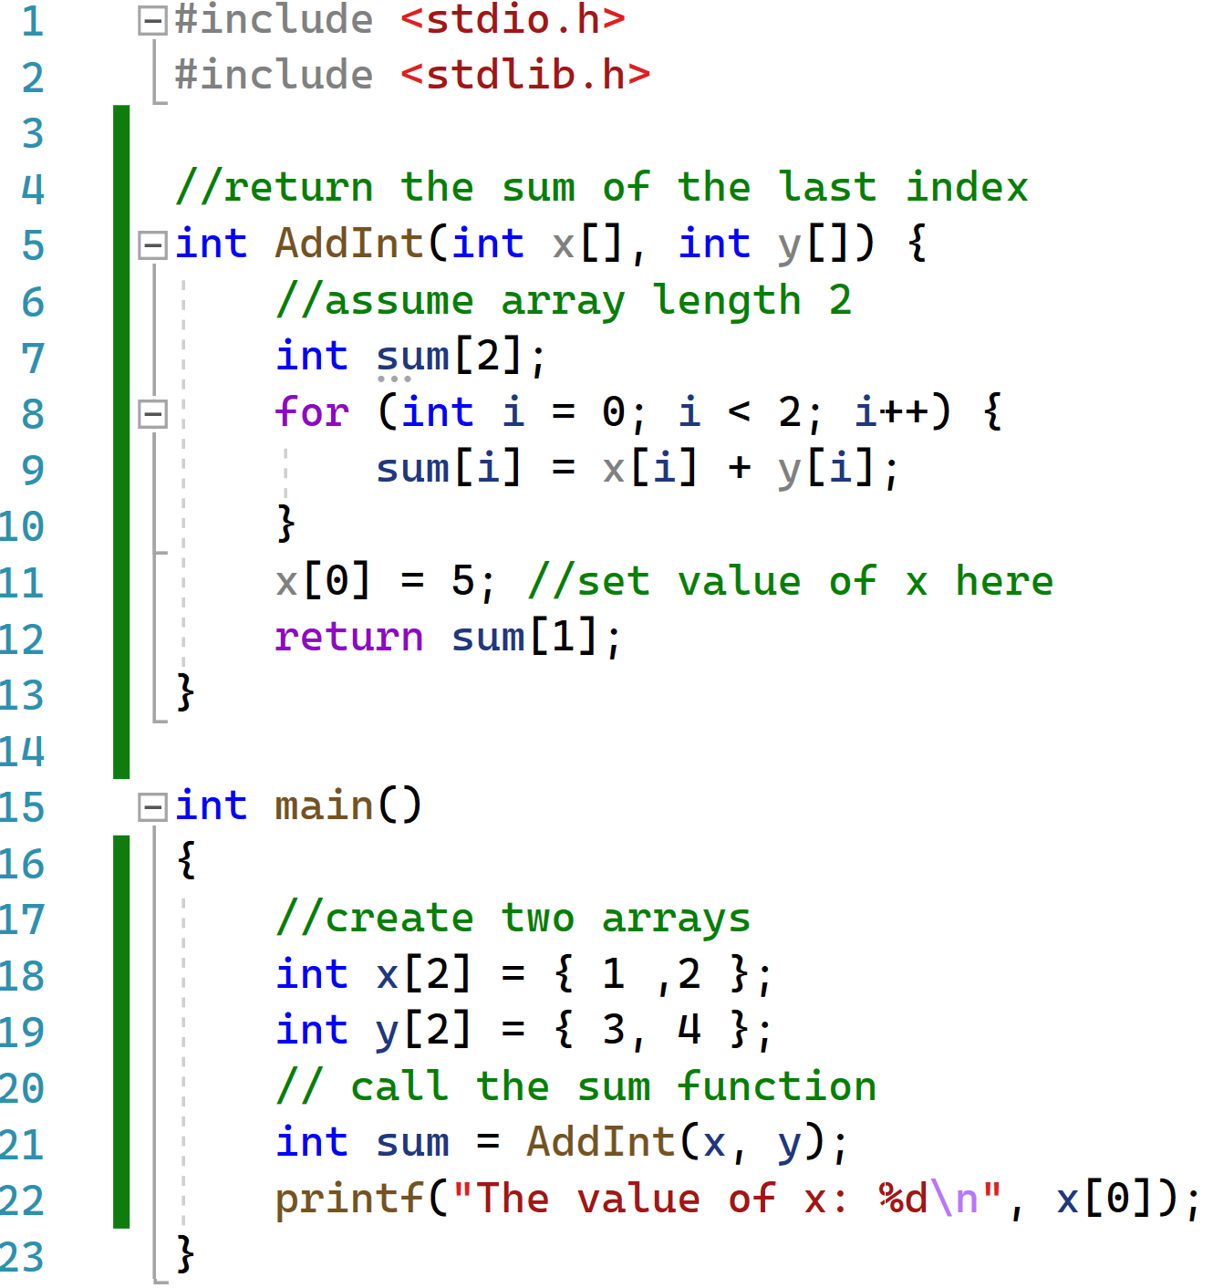
Passing by reference

Slide 27
Passing by reference
Variables in Main
x ={1, 2}
y= {3, 4}

Slide 28
Passing by reference
Variables in Main
x ={1, 2}
y= {3, 4}
Variables in AddInt

Slide 29
Passing by reference
Variables in Main
x ={1, 2}
y= {3, 4}
Variables in AddInt
x=
y=

Slide 30
Passing by reference
Variables in Main
x ={1, 2}
y= {3, 4}
Variables in AddInt
x=
y=
Sum={0,0}

Slide 31
Passing by reference
Variables in Main
x ={1, 2}
y= {3, 4}
Variables in AddInt
x=
y=
Sum={4,6}

Slide 32
Passing by reference
Variables in Main
x ={5, 2}
y= {3, 4}
Variables in AddInt
x=
y=
Sum={4,6}

Slide 33
Passing by reference
Variables in Main
x ={5, 2}
y= {3, 4}
sum =6
Variables in AddInt
x=
y=
Sum={4,6}

Slide 34

Passing by reference
Variables in Main
x ={5, 2}
y= {3, 4}
sum =6
Variables in AddInt
x=
y=
Sum={4,6}

Slide 35
Understanding Passing by Reference
Pay careful attention to the previous example.
Arrays are NOT PRIMITIVE datatypes.
When you pass arrays to a method you DO NOT get an independent copy. You get a reference to where the original array is stored in memory.
A bit confused?

Slide 36
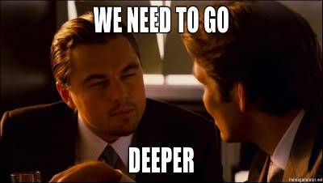
Why did the film Inception have this iconic quote?
There are two possibilities:
1. They were talking about dreams (unlikely).
2. They were talking about understanding pointers and memory in C programming.

Slide 37
1. Arrays in C
2. Passing By Value
3. Passing By Reference
4. Pointers and Memory in C

Slide 38

Pointers and Memory in C
Let’s talk about where you live.
Assume you have a house.
Where is the house?
At an address.
When discussing where you live two pieces of information are important.
The address of your house, and the house itself.

Slide 39

Pointers and Memory in C
For C programming two things are important: The value of a variable and where that variable lives in memory.
Your house = A variables value
House Address = the address in computer memory
In C we call a reference to the address in computer memory a pointer.

Slide 40
Variables and Memory
The memory is an array of bytes
Every byte in memory is numbered: the address!
An address is just an unsigned integer
Every variable is kept in memory, and is associated with two numbers: -The address
-The value stored at that address

Slide 41
Referencing and dereferencing
Two new operators
& Reference: "get" the address of something
* Dereference: "use" the address

Slide 42
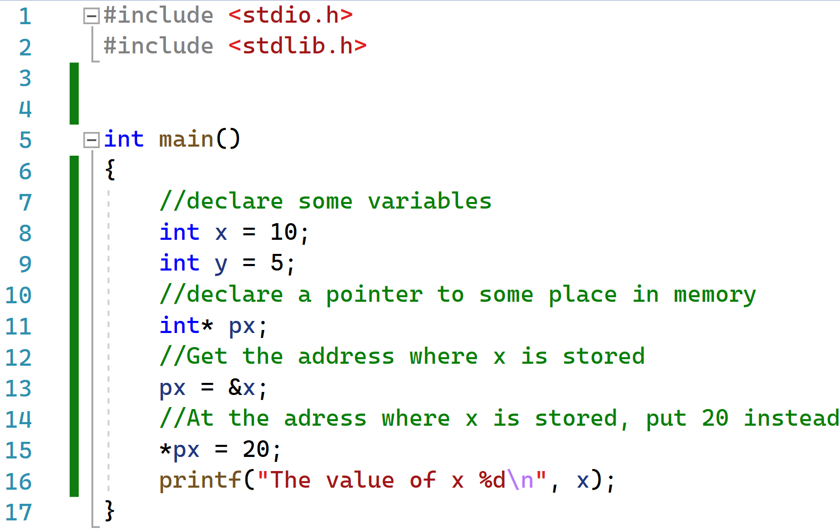
Pointer Example using “&”
Computer Memory
 | Address | Value
 | 1028
 | 1024
 | 1020
 | 1016
 | 1012
 | 1008
 | 1004
 | 1000

Slide 43
Pointer Example using “&”
Computer Memory
 | Address | Value
 | 1028
 | 1024
 | 1020
 | 1016
 | 1012
 | 1008
 | 1004
 | 1000

Slide 44
Pointer Example using “&”
Computer Memory
 | Address | Value
 | 1028
 | 1024
x | 1020 | 10
 | 1016
 | 1012
 | 1008
 | 1004
 | 1000

Slide 45
Pointer Example using “&”
Computer Memory
 | Address | Value
 | 1028
 | 1024
x | 1020 | 10
y | 1016 | 5
 | 1012
 | 1008
 | 1004
 | 1000

Slide 46
Pointer Example using “&”
Computer Memory
 | Address | Value
 | 1028
 | 1024
x | 1020 | 10
y | 1016 | 5
px | 1012 | ?
 | 1008
 | 1004
 | 1000

Slide 47
Pointer Example using “&”
Computer Memory
 | Address | Value
 | 1028
 | 1024
x | 1020 | 10
y | 1016 | 5
px | 1012 | 1020
 | 1008
 | 1004
 | 1000
The & symbol is saying take the address of where x is stored and store that address value in px

Slide 48
Pointer Example using “&”
Computer Memory
 | Address | Value
 | 1028
 | 1024
x | 1020 | 20
y | 1016 | 5
px | 1012 | 1020
 | 1008
 | 1004
 | 1000
The * symbol is saying take what is stored at the address that px of is pointing to and put 20

Slide 49

Pointer Example using “&”
Computer Memory
 | Address | Value
 | 1028
 | 1024
x | 1020 | 20
y | 1016 | 5
px | 1012 | 1020
 | 1008
 | 1004
 | 1000

Slide 50
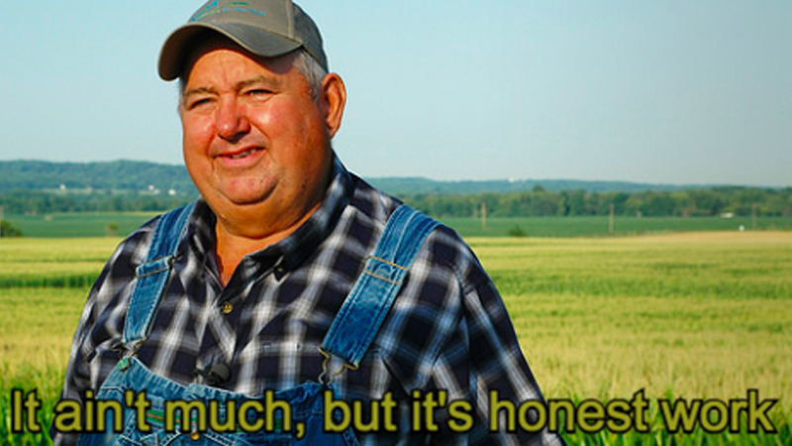
How would we use pointer with arrays?
Previously we showed how we could pass arrays as inputs to functions.
What if we want to pass arrays as outputs?
We can use pointers. Since a function can only return “one variable” in C, we’ll return a pointer to the start of the array!
Return the pointer instead of the entire array:

Slide 51
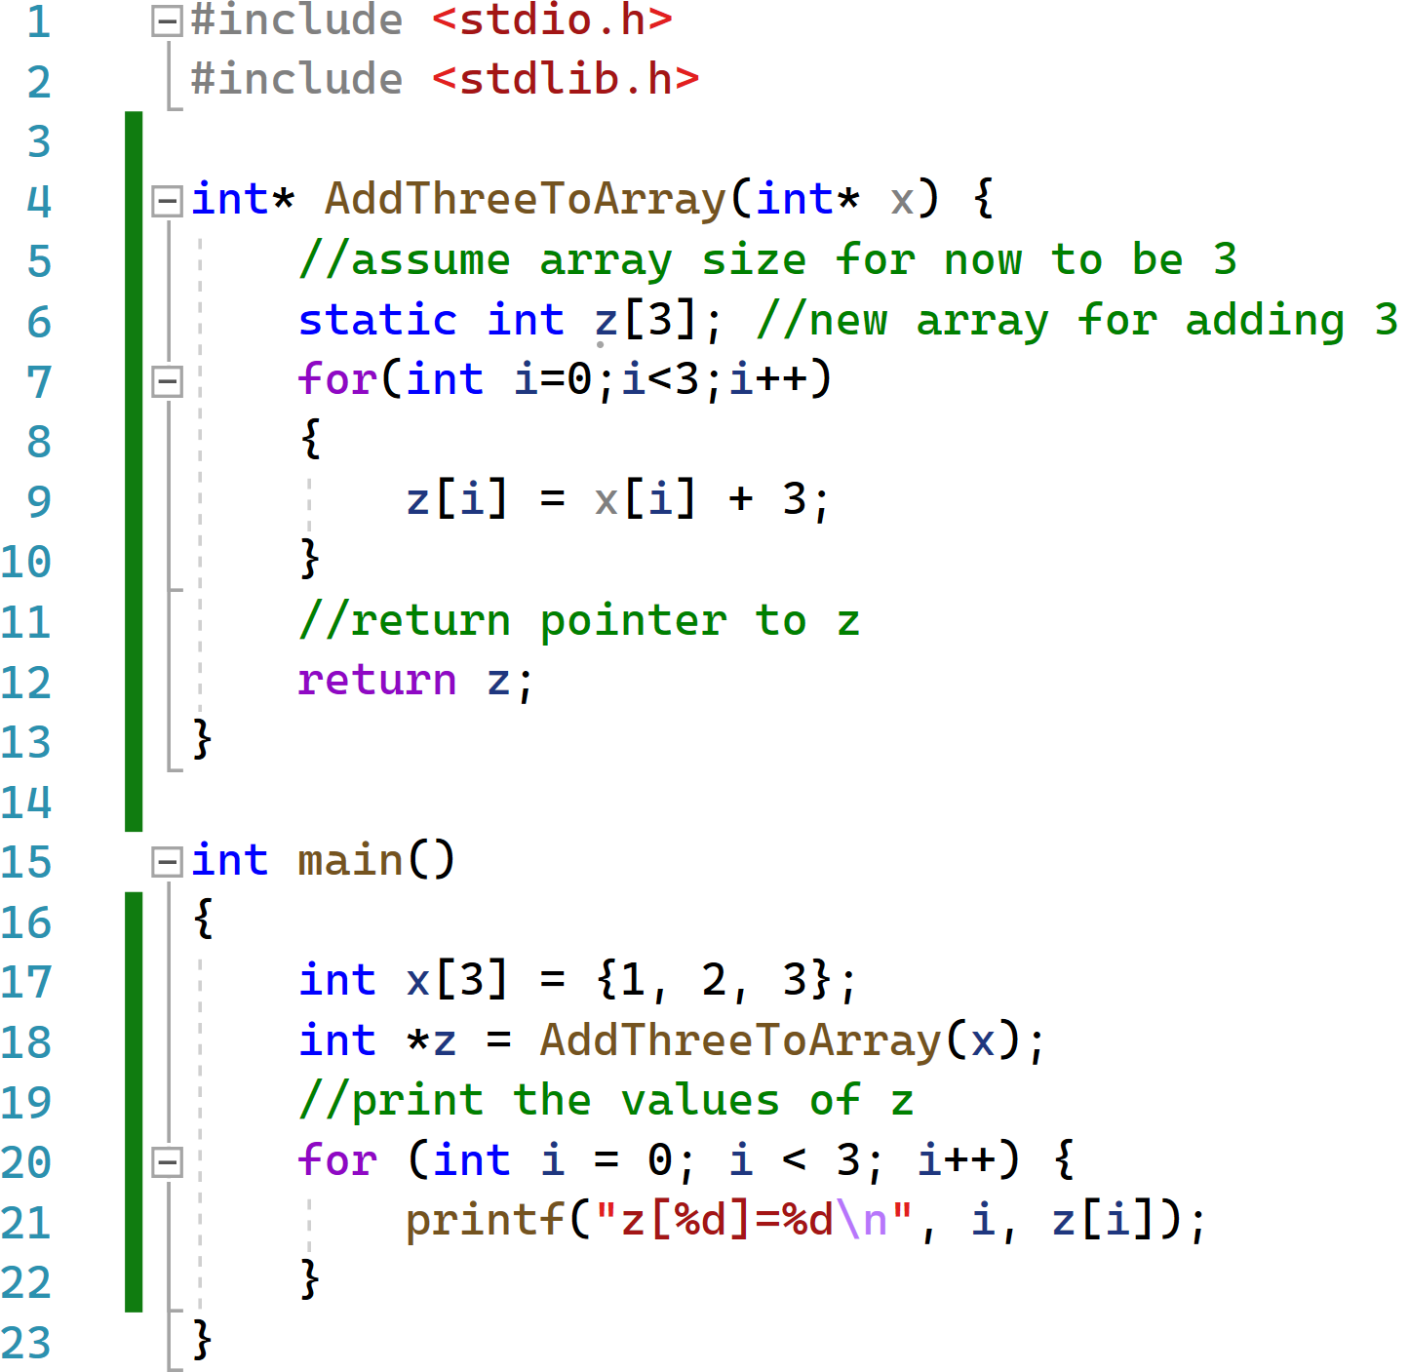
Pointer Example: Returning an Array
Variables in Main

Slide 52
Pointer Example: Returning an Array
Variables in Main
X =[1,2,3]

Slide 53
Pointer Example: Returning an Array
Variables in Main
X =[1,2,3]
Variables in Method

Slide 54
Pointer Example: Returning an Array
Variables in Main
X =[1,2,3]
Variables in Method
X

Slide 55
Pointer Example: Returning an Array
Variables in Main
X =[1,2,3]
Variables in Method
X
Z=[?,?,?]

Slide 56
Pointer Example: Returning an Array
Variables in Main
X =[1,2,3]
Variables in Method
X
Z=[4,5,6]

Slide 57
Pointer Example: Returning an Array
Variables in Main
X =[1,2,3]
Variables in Method
X
Z=[4,5,6]

Slide 58
Pointer Example: Returning an Array
Variables in Main
X =[1,2,3]
Z
Variables in Method
X
Z=[4,5,6]

Slide 59
Pointer Example: Returning an Array
Variables in Main
X =[1,2,3]
Z
Variables in Method
X
Z=[4,5,6]

Slide 60
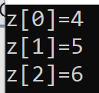
Pointer Example: Returning an Array
Variables in Main
X =[1,2,3]
Z
Variables in Method
X
Z=[4,5,6]

Slide 61
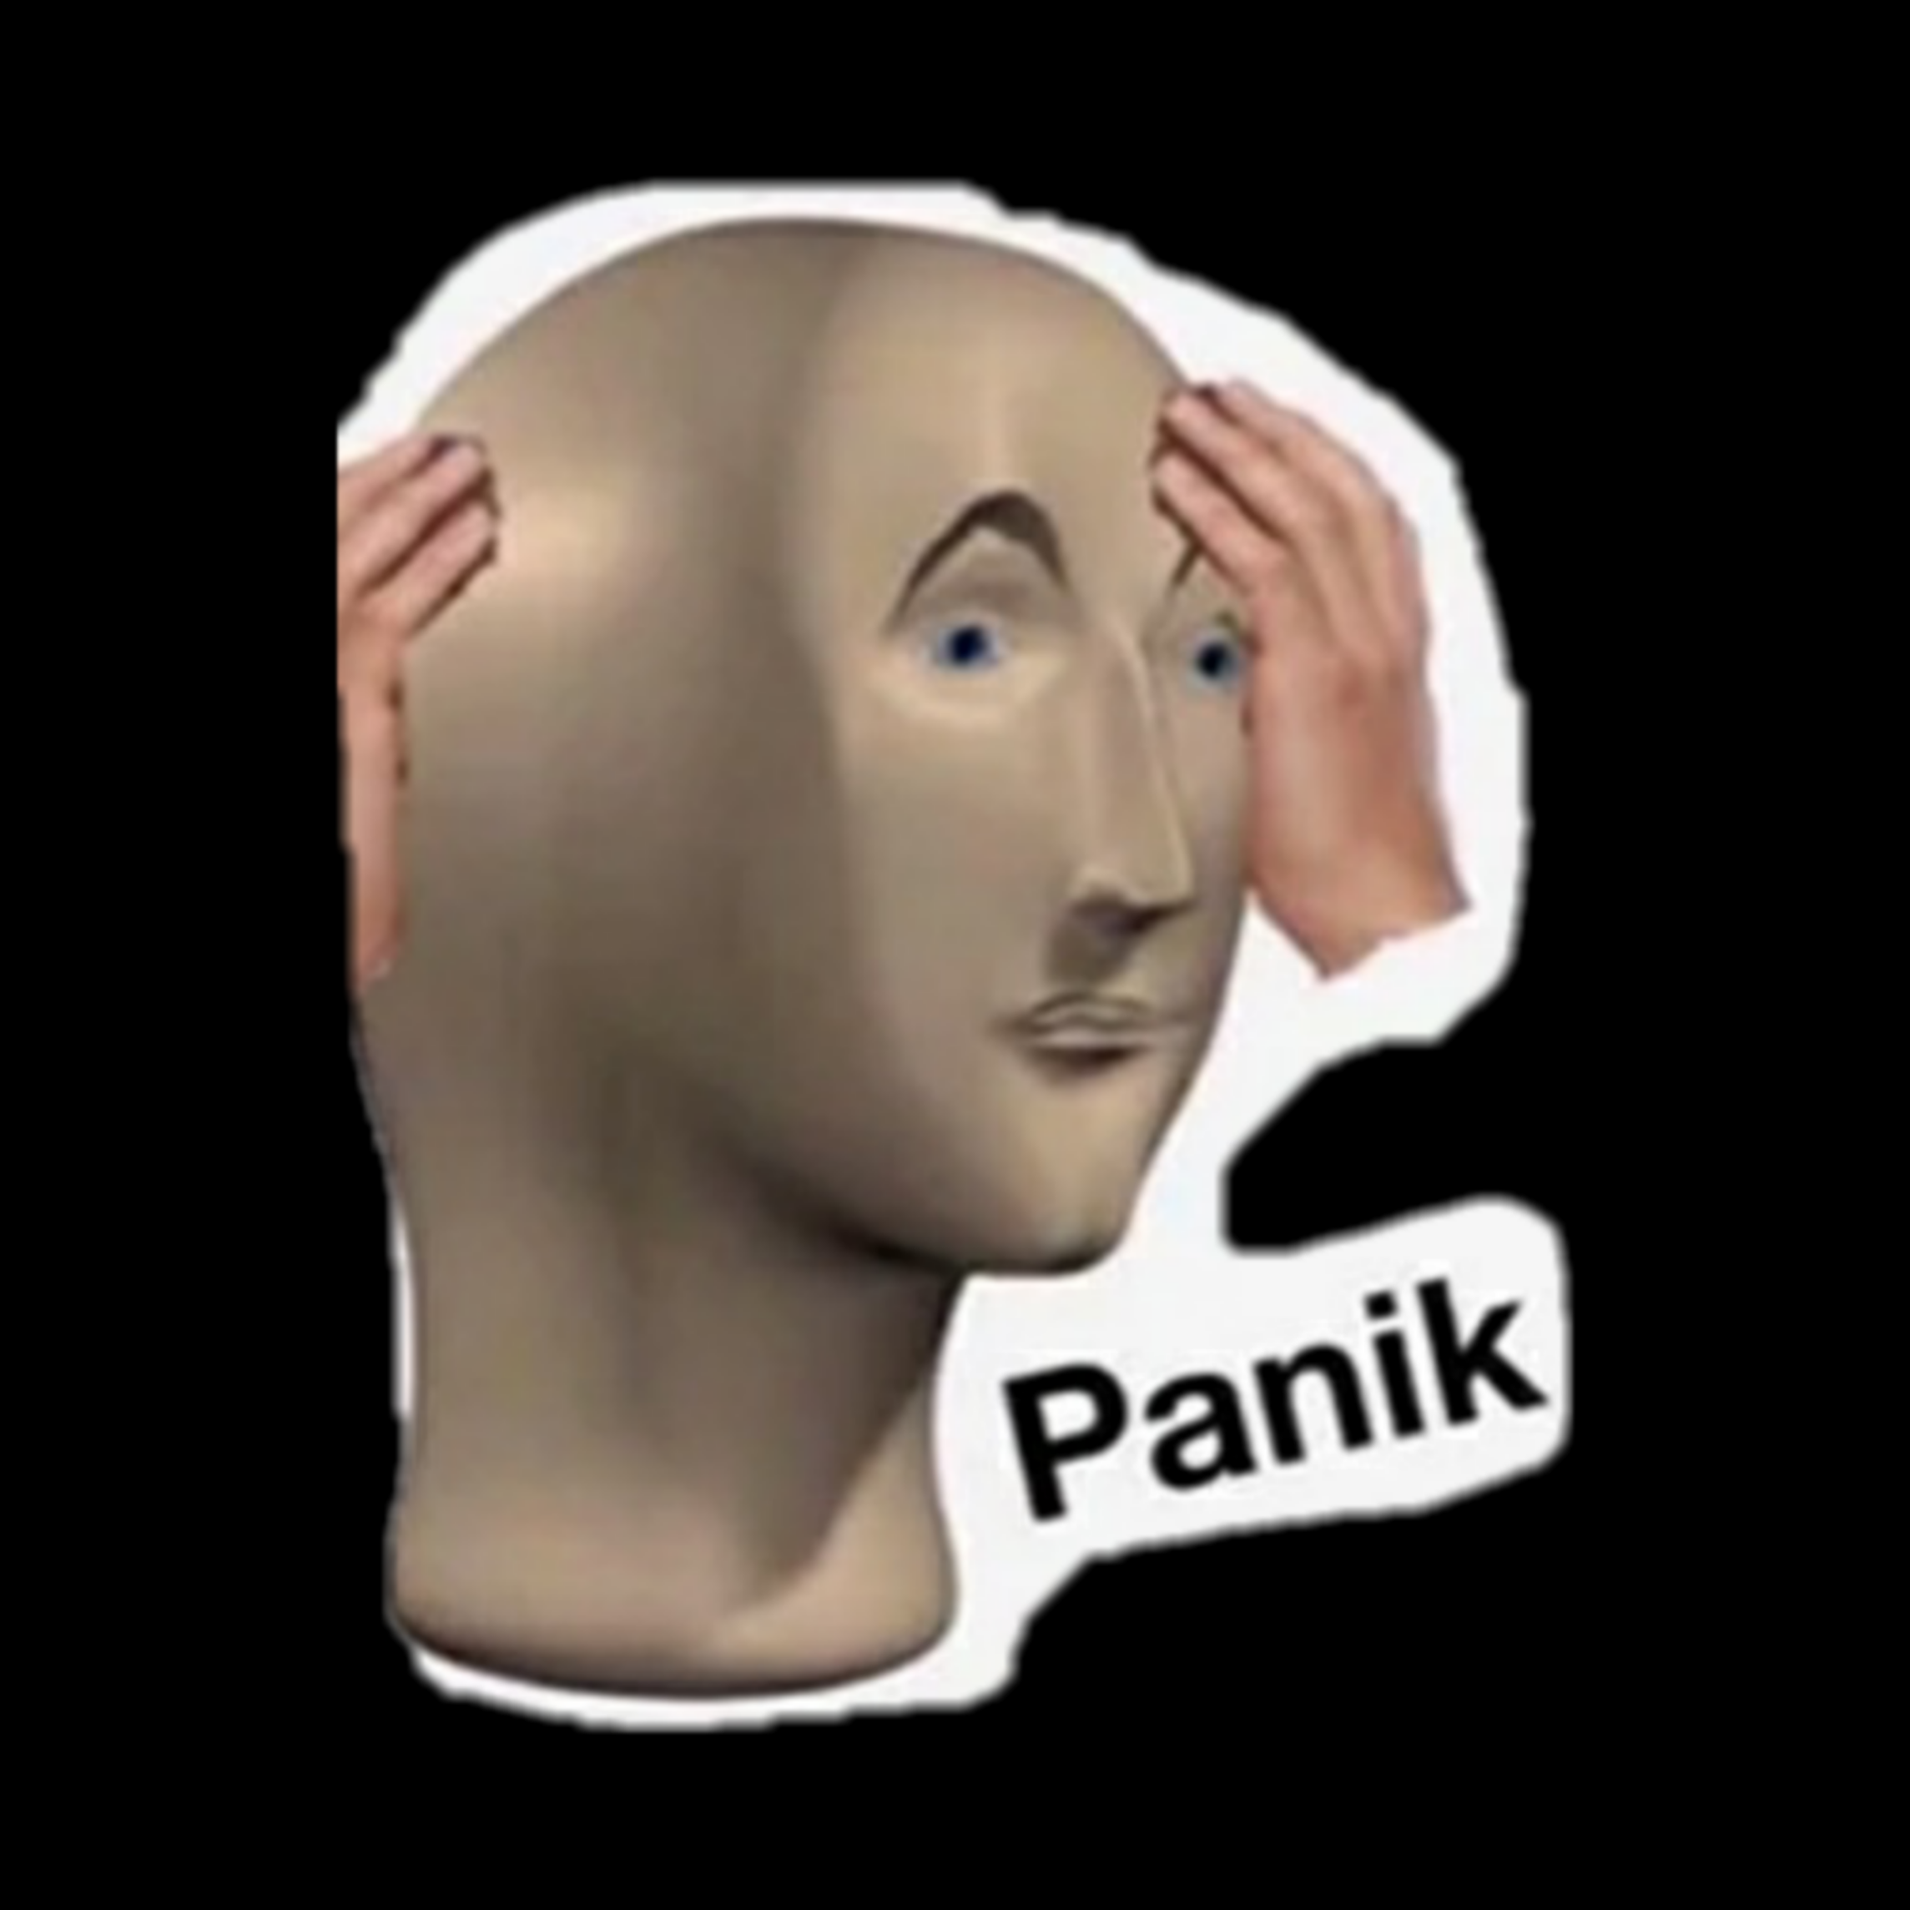
Are there any problems with this approach?
What happens if we want to use the function multiple times?
We only have static variable so every time z will get overwritten.

Slide 62
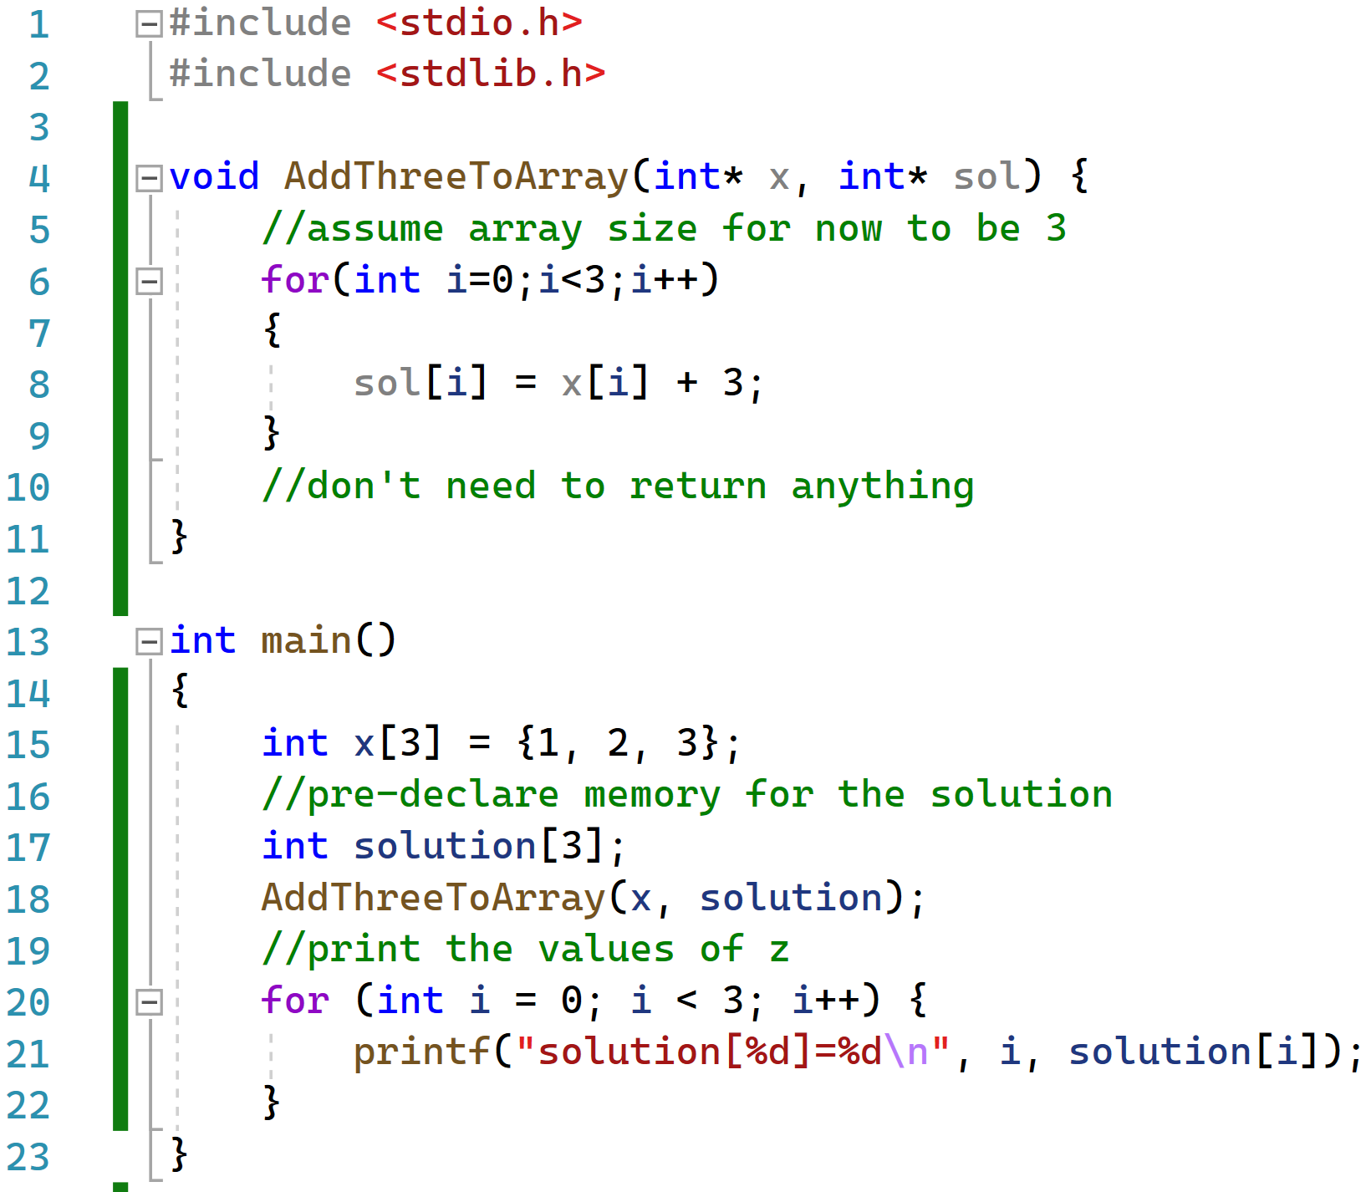
Fixing the Array Return Code in C

Slide 63
Fixing the Array Return Code in C

Slide 64
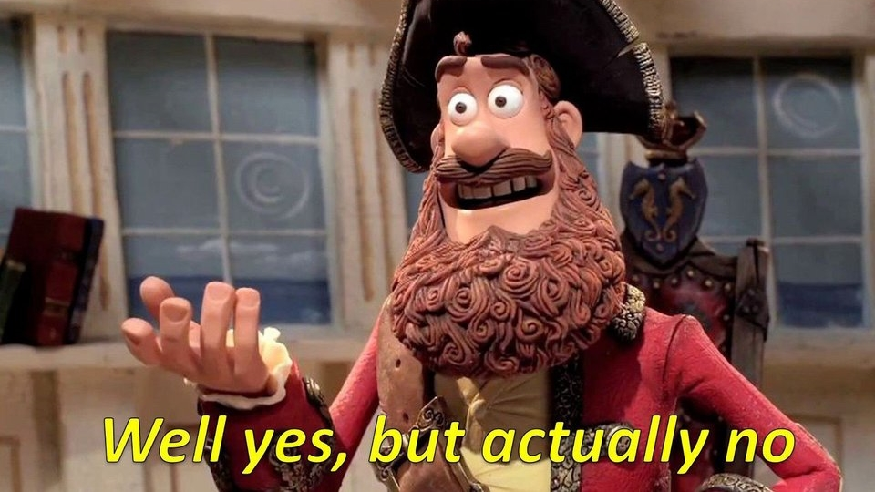
Fixing the Array Return Code 2
When we want to do array manipulation with functions, is the previous solution the ONLY way to fix the code ?
The short answer: Yes (with the tools you have learned so far).
The long answer: No. There are other ways but we’ll need to delve into some new features of C in an exciting future lecture!

Slide 65
A few misc but related pointer/array topics

Slide 66
Pointer declarations
Word to the wise…
The following declarations are equivalent
They all declare…
p to be a pointer to an integer
But
First one makes the above statement clear
Second one is “non-committing”
Third says that what p points to is an integer (classic C style)
int* p;
int * p;
int *p;

Slide 67
Pitfalls of Pointer Declarations
Consider the following declarations:
int *a, b;
int* c, d;
int e, *f;
int *g, *h;
What are the types of the variables?
a, c, f, g, h are int *
b, d, e are int

Slide 68
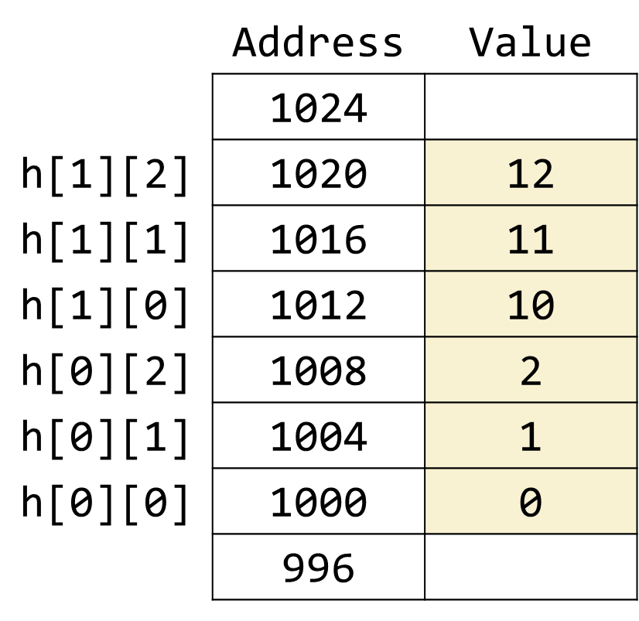
Multidimensional arrays
// declaration and initialization
int h[2][3] = { {0, 1, 2}, {10, 11, 12} };
Array layout in memory:
(assuming an int has four bytes)
Row 0 first, then Row 1, ...
In each row: column 0 first, then column 1, …
Visualization of the Array
 | 0 | 1 | 2
0 | 0 | 1 | 2
1 | 10 | 11 | 12

Slide 69
Lecture Conclusions
In C we have different types of variables: primitives and non-primitives.
When variables are given as input to a function, primitives are copied by value, non-primitives are copied by reference.
In C we have variables and their address in memory. The two operators to deals with this are “*” and “&”.

Slide 70
Figure Sources
https://wompampsupport.azureedge.net/fetchimage?siteId=7575&v=2&jpgQuality=100&width=700&url=https%3A%2F%2Fi.kym-cdn.com%2Fentries%2Ficons%2Ffacebook%2F000%2F026%2F366%2Fpather.jpg
https://i.kym-cdn.com/photos/images/newsfeed/000/531/557/a88.jpg
https://loveincorporated.blob.core.windows.net/contentimages/main/2ba923f2-25b7-403b-b3c3-95ac2016c7bb-shire-hobbit-home.jpg
https://s3.amazonaws.com/pix.iemoji.com/images/emoji/apple/ios-12/256/backhand-index-pointing-right.png
https://i.kym-cdn.com/entries/icons/original/000/028/021/work.jpg
https://i.imgur.com/i9JNNvJ.jpg
https://i.kym-cdn.com/entries/icons/original/000/028/596/dsmGaKWMeHXe9QuJtq_ys30PNfTGnMsRuHuo_MUzGCg.jpg

